Slide 1

StackStorm Architecture
Installing and Configuring StackStorm Using Quick Install
NarendraP
StackStorm: Event-Driven Automation Tool for DevOps and Infrastructure

Slide 2
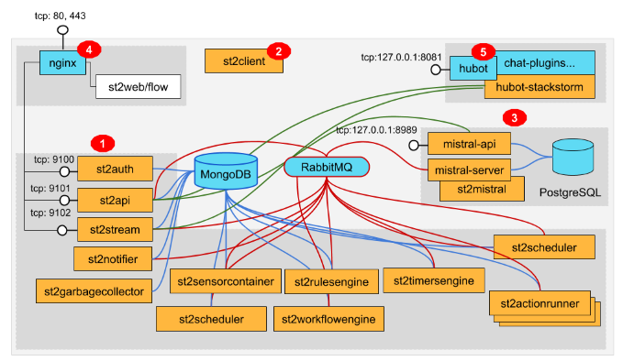
StackStorm Architecture
StackStorm Architecture Diagram:
StackStorm: Event-Driven Automation Tool for DevOps and Infrastructure

Slide 3
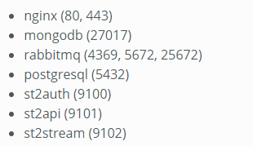
Quick Installation Steps
Quick Installation is way to Automatically Install and Configure StackStorm with a shell script on a standalone system.
But here we have one small problem.
Actually StackStorm Consist of Different Services and they are running on different ports.
Note: we need clean or fresh 64 bit Linux OS.
StackStorm: Event-Driven Automation Tool for DevOps and Infrastructure

Slide 4
Thank you

Slide 5
Quick Installation Steps…
Quick Installation is one-line installation.
curl -sSL https://stackstorm.com/packages/install.sh | bash -s -- --user=st2admin --password='Ch@ngeMe‘
Verify StackStorm Version using: st2 --version and Python Version Used.
Verify Different Services Installed for StackStorm.
Important Paths:
/opt/stackstorm
/etc/st2 and /etc/st2/st2.conf
/var/log/st2
Note:
StackStorm Automation tasks will run by default with stanley system user on OS.
We can see this info from /etc/st2/st2.conf file.
Password-less Sudo access also given to the stanley.
Note: We can also Modify stanley system user into our custom user.
One-line/Quick Install process will automatically start stackstorm even if we reboot system.
StackStorm: Event-Driven Automation Tool for DevOps and Infrastructure

